Slide 1
Lab 5: Basic Filters and Frequency Response
EE316-08 Spring 2021

Slide 2
Purpose: The goal of this laboratory is to study the frequency characteristics of Low and High Pass Filters. Specifically, signal amplitude, signal phase, and how they are related to input frequency. In addition, the concept of cutoff frequency will be introduced.

Slide 3
Background
A filter is a circuit that allows a specific range of input frequencies to pass through while blocking other input frequencies.
Example of filters application: In radio communications, filter helps reject all undesired signals while radio receiver receives the desired signals.
In general, there are two types of filters – passive filters and active filters.
Passive filter is designed to use passive elements such as resistors, capacitors, and inductors. It is good for radio frequencies application. The most responsive frequency range for this filter type is between 100 Hz to 300 MHz.
Active filter, unlike passive filter, is designed to use op-amps, resistors, and capacitors. Inductors are not needed. This filter type can handle very low frequency input signals. However, at high frequency input signal, this filter can become unreliable.

Slide 4
Background (cont.)
In this lab, we focus on basic low pass filters (LPF) and high pass filters (HPF).
LPF passes low-frequency components but blocks high-frequency components of the input signal.
HPF passes high-frequency components but blocks low-frequency components of the input signal.

Slide 5



Low Pass Filter (LPF)
LPF passes low-frequency components but blocks high-frequency components of the input signal.
Input signals
Output signals
Low
Frequency
Low
Frequency
$$V_{IN}$$
$$V_{OUT}$$
Low Pass Filter (LPF)
Cutoff frequency ($f_{c}$) (Hz)
Gain = -3 dB
Gain (dB)
Attenuated
High
Frequency
Passed
Frequency (Hz)

Slide 6
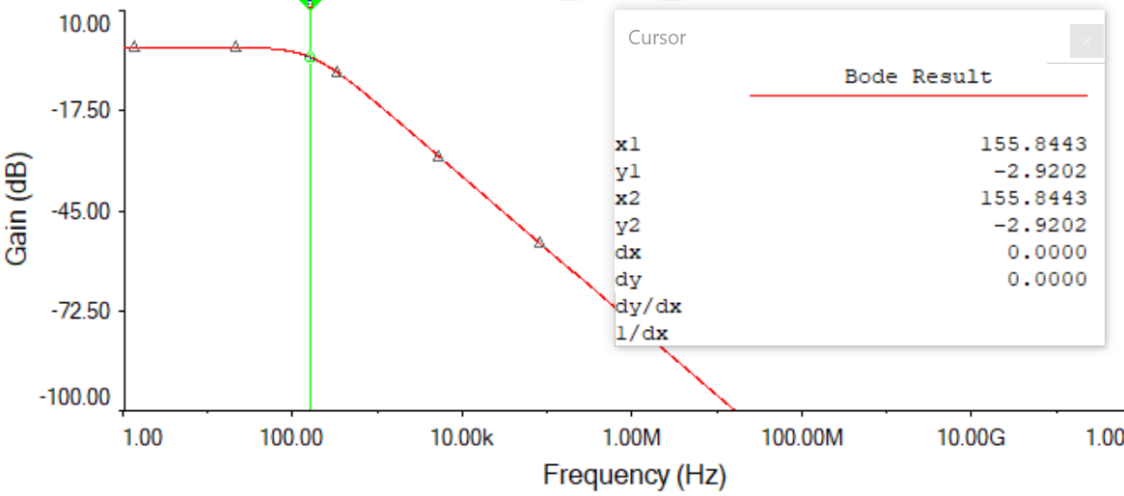
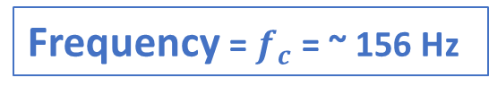
Low Pass Filter (LPF) (cont.)
Gain = -3 dB
Frequency = $f_{c}$ = ~ 156 Hz

Slide 7
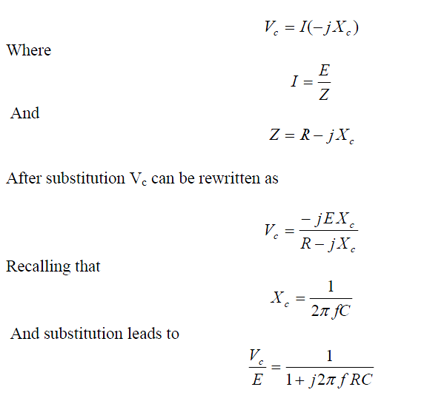
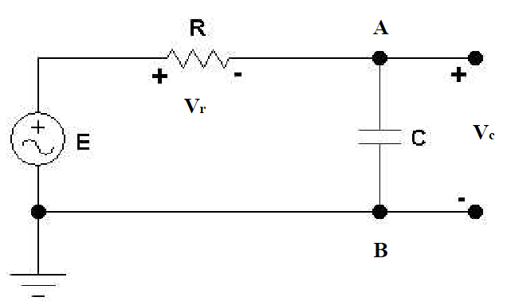
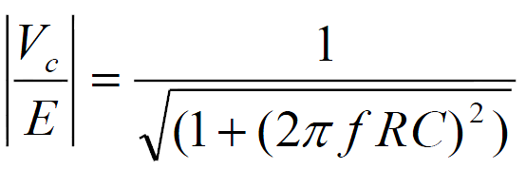
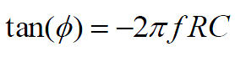



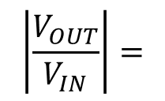


Low Pass Filter (LPF) (cont.)
$$Ι$$
Figure 5.1
*Definition of the impedance of capacitor
Gain:
$$\left|\frac{V_{OUT}}{V_{IN}}\right|=$$
Phase Angle:

Slide 8

High Pass Filter (HPF)
HPF passes high-frequency components but blocks low-frequency components of the input signal.
Input signals
Output signals
Low
Frequency
High
Frequency
$$V_{IN}$$
$$V_{OUT}$$
High Pass Filter (HPF)
Cutoff frequency ($f_{c}$) (Hz)
Gain = -3 dB
Attenuated
Gain (dB)
Passed
High
Frequency
Frequency (Hz)

Slide 9
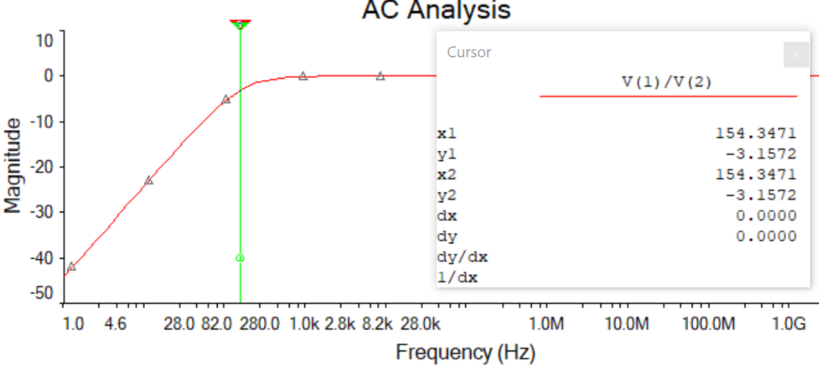
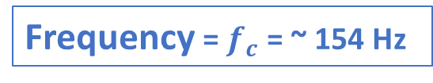
High Pass Filter (HPF) (cont.)
Gain = -3 dB
Frequency = $f_{c}$ = ~ 154 Hz

Slide 10
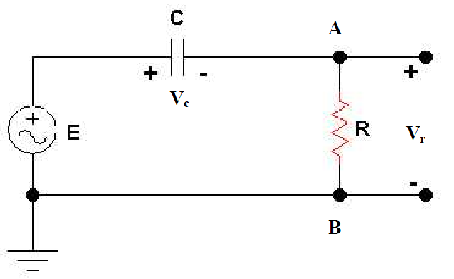
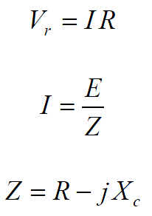
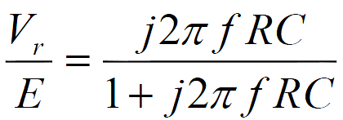
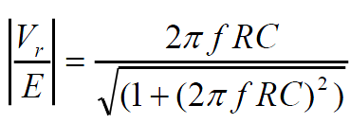
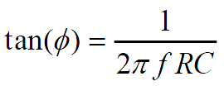





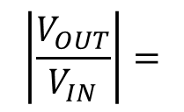
High Pass Filter (HPF) (cont.)
$$Ι$$
Figure 5.2
Gain:
Phase Angle:
$$\left|\frac{V_{OUT}}{V_{IN}}\right|=$$

Slide 11
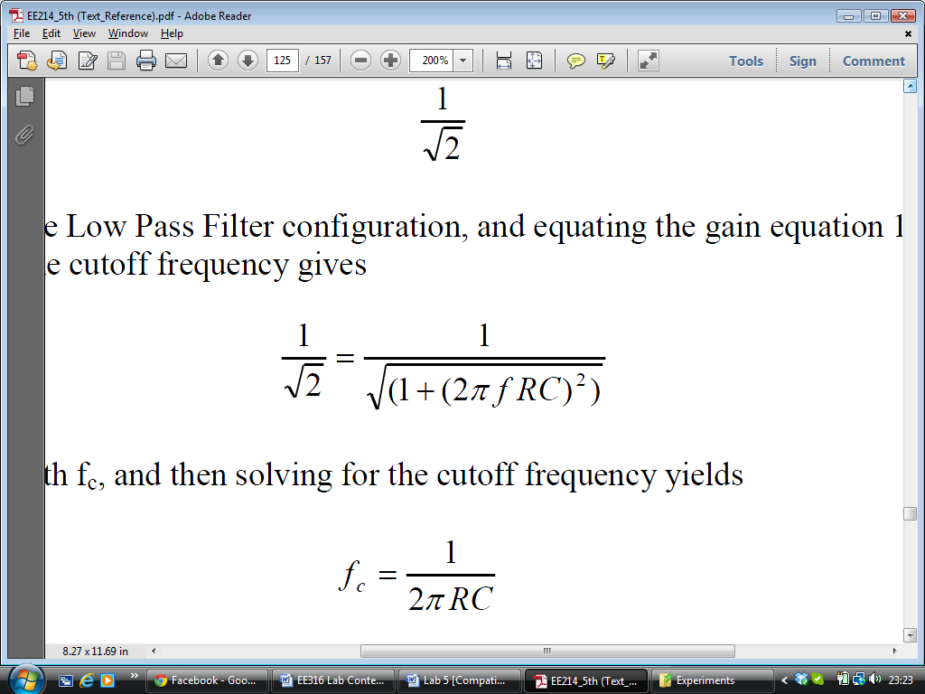
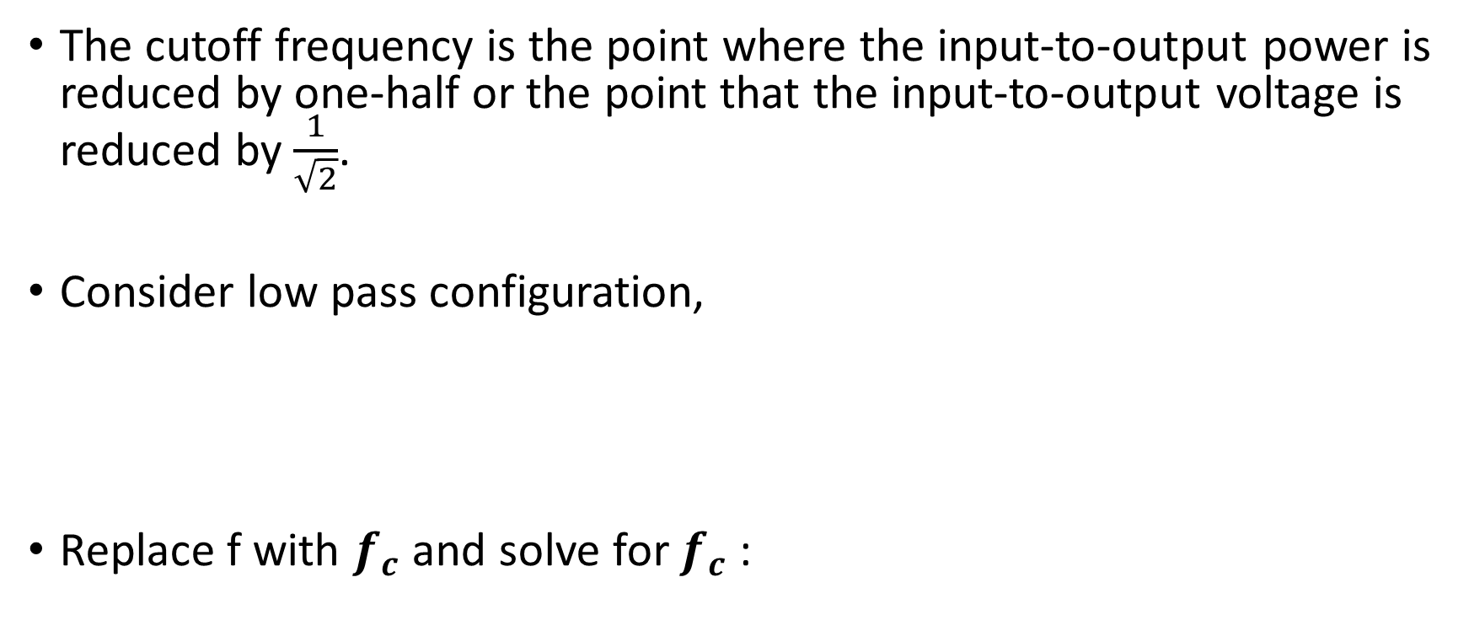



Cutoff Frequency ($f_{c}$)
The cutoff frequency is the point where the input-to-output power is reduced by one-half or the point that the input-to-output voltage is reduced by $\frac{1}{\sqrt{2}}$.
Consider low pass configuration,
Replace f with $f_{c}$ and solve for $f_{c}$:
Gain:
$$\left|\frac{V_{OUT}}{V_{IN}}\right|=$$
$$\frac{\frac{E}{\sqrt{2}}}{E}=$$

Slide 12
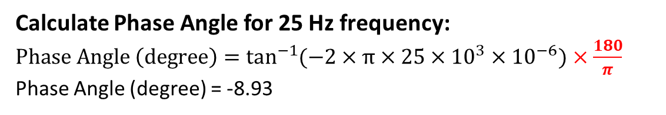
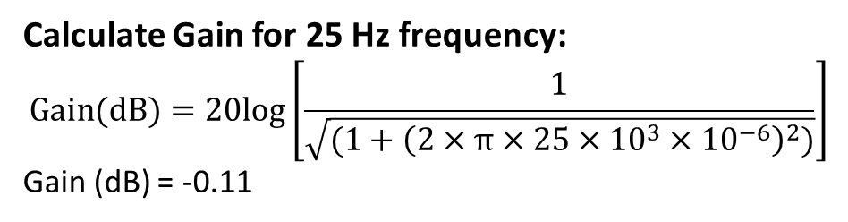

Calculations for LPF
Gain:
Frequency (Hz) | Gain (dB) | Phase Angle (degree)
25 | -0.11 | -8.93
50
75
100
150
200
300
500
600
700
800
900
1000
$$\left|\frac{V_{OUT}}{V_{IN}}\right|=$$
Calculate Gain for 25 Hz frequency:
$$Gain(dB)=20log\left[\frac{1}{\sqrt{(1+{\left(2×π×25×{10}^{3}×{10}^{−6}\right)}^{2})}}\right]$$
Gain (dB) = -0.11
Phase Angle:
Calculate Phase Angle for 25 Hz frequency:
$Phase Angle \left(degree\right)=\tan^{−1}{(−2×π×25×{10}^{3}×{10}^{−6})}$ $×\frac{180}{π}$
Phase Angle (degree) = -8.93

Slide 13
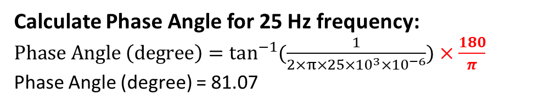
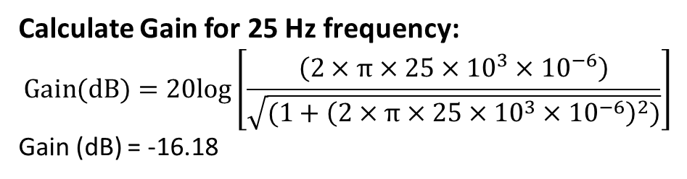
Calculations for HPF
Frequency (Hz) | Gain (dB) | Phase Angle (degree)
25 | -16.18 | 81.07
50
75
100
150
200
300
500
600
700
800
900
1000
Gain:
$$\left|\frac{V_{OUT}}{V_{IN}}\right|=$$
Calculate Gain for 25 Hz frequency:
$$Gain(dB)=20log\left[\frac{\left(2×π×25×{10}^{3}×{10}^{−6}\right)}{\sqrt{(1+{\left(2×π×25×{10}^{3}×{10}^{−6}\right)}^{2})}}\right]$$
Gain (dB) = -16.18
Phase Angle:
Calculate Phase Angle for 25 Hz frequency:
$Phase Angle \left(degree\right)=\tan^{−1}{(\frac{1}{2×π×25×{10}^{3}×{10}^{−6}})}$ $×\frac{180}{π}$
Phase Angle (degree) = 81.07

Slide 14
Summary
Lab 5 Report & Pre-lab 6 are due on Wednesday 24th February 2021 by midnight.
Fill out Table 5.1 and 5.2 with numbers from…
Simulation
Calculations
Experimental results

